Slide 1
Deployment of Microservices with Kubernetes and Helm
tt.mm.2020, Bastian Drüsedow

Slide 2
Agenda
Motivation
CD/CI Pipeline
Jenkins
Versioning
Docker
Kubernetes
Deployment with Kubernetes
Helm – Kubernetes package manager
Conclusion
Hands-On
Notes:
Motivation
CD/CI Pipeline (Begriffe erklären)
Docker (bekannteste Containertechnologie)
Versioning (Versionierung der Container ist essentiell für ein Deployment)
Kubernetes (Kubernetes – Containerorchestrierung)
Deployment with Kubernetes (mit Beispiel)
Helm – Kubernetes package manager (wiederverwendbare und komplexe Deployments)
Jenkins (Pipeline Server)
Conclusion

Slide 3
Motivation
Automate deployments and management for microservices
Make delivery process faster and easier
Introduce important technologies and tools for microservice deployment
Notes:
Strategie zum Deployment von Microservices näher bringen
Vorstellung der wichtigsten Tools und Technologien
Dabei auf „Best of Breed“ konzentrieren: Docker, Kubernetes, Helm …

Slide 4
CI/CD Pipeline
CI/CD pipelines handle recurring processes in the application development.
Split into:
CI = Continuous Integration CD = Continuous Delivery
Checkout
Build App
Test
Version Artifacts
Build Image
Archive Image
Deployment
End-to-end Test
Monitoring (Rollback)
Notes:
Wiederkehrende Prozesse in der Entwicklung von Microservices
Pipeline arbeitet Prozesse Schritt für Schritt ab
Angestoßen durch Commit in Repository, Kompilieren, automatisierte Tests, Bauen von Containern (-> siehe Docker), Deployment, Monitoring)
Lässt sich unterteilen in CI/CD

Slide 5
CI Pipeline
Checkout
Build App
Test
Version Artifacts
Build Image
Archive Image
Deployment
End-to-end Test
Monitoring (Rollback)
Continous Integration
Notes:
CI: Zusammenfügen aller Komponenten zu einer Anwendung
Pipelines laufen meist nicht lokal, deshalb checkout
Kompilieren
Unit und Integrationstests, Ergebnisse werden archiviert, bei Fehler -> abgebrochen (das gilt für alle Schritte)
Artefakte Versionieren (klingt einfach, kann aber komplex werden bei größeren Projekten) -> siehe Versioning
Bauen eines Containerimages -> siehe Docker
Archivieren in einer Registry oder in einem Repository

Slide 6
CD Pipeline
Checkout
Build App
Test
Version Artifacts
Build Image
Archive Image
Deployment
End-to-end Test
Monitoring (Rollback)
Continous Integration
Continous Delivery
Notes:
CD: Deployment, Testing, Monitoring

Slide 7
Versioning
Versioning

Slide 8

Jenkins
Jenkins…
is an open source automation server.
runs on every machine with java.
is capable of being extended with plugins.
uses Pipelines to work.
Jenkins builds and tests software continuously and monitors the execution and status of remote jobs, making it easier for team members and users to regularly obtain the latest stable code.
Jenkins on GitHub:
Notes:
führende Open Source CI/CI Tool bzw. Automatisierungsserver
2004 Ursprünglich als „Hudson Project“ gesartet
Von Sun Microsystems entwickelt
Nach Übernahme durch Orcacle 2010 dann in Jenkins umbenannt
Über Zeit 600 Mitwirkende Entwickler auf GitHub

Slide 9
Jenkins Build Jobs
Jenkins
Notes:
Jenkins arbeitet mit Pipelines
darin Stages definiert, die nacheinander abgearbeitet werden

Slide 10

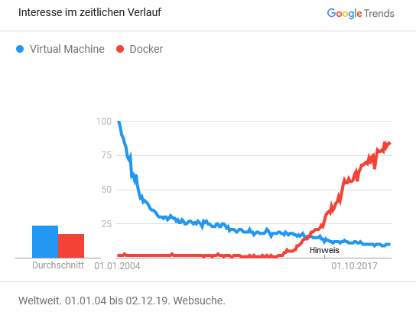
What is Docker?
What is Docker?
Best of breed container technology
Create, deploy, run containers
What is a Docker Container?
application + all dependencies and libraries
Ship application as one package
Notes:
Bekannteste Containertechnologie
Verpacken von Software mit allen Abhängigkeiten
laufen unabhängig von Prozessen anderen Prozessen
Container = Standardeinheit von Softwarepaketen
Beinhaltet Software, Libraries, Abhängigkeiten, Konfigurationen
kann ausgeliefert werden (verschifft) (Docker = Hafenarbeiter -> Aufgabe ist Container verpacken und verschiffen)

Slide 11
Why use Docker?
Containers…
are lightweight
only include executables and dependencies
always share the same OS
require no hypervisor
can share some of their image files
are very fast
VM
App A
App B
Container
Bins/Libs
Bins/Libs
App A
App B
Guest OS
Guest OS
Bins/Libs
Bins/Libs
Hypervisor
Docker Engine
Host OS
Host OS
Server
Server
Start Time: | 30-45 sec | < 50 ms
Stop Time: | 5-10 sec | < 50 ms
Notes:
Grafik erklären:
VM braucht Abstraktionsschicht um Gast OS auf Host OS laufen zu lassen
Container braucht kein Gast OS, teilt sich den Kernel mit Host und anderen Containern
Heißt aber auch das Kernel Architektur gleich sein muss (ARM Linux -> ARM Linux, x86 Linux und Windows Host -> x86 Linux Container)
Container muss nur Binaries und Bibliotheken selbst halten -> nur absolut notwendiges -> sehr leichtgewichtig
Container können Imagefiles teilen
Beispiel: 2 Container in denen Java Apps laufen -> wenn gleiches Basisimage, können beide Container das gleiche Image benutzen
Start und Stopzeiten (evtl vorführen eines Containerstarts)

Slide 12
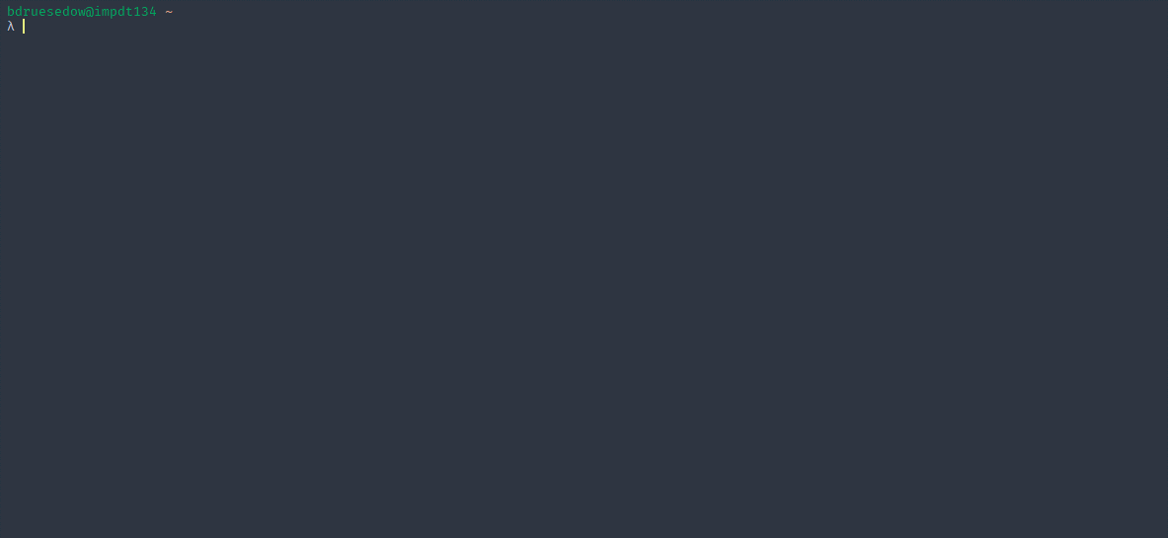

Docker - Demonstration

Slide 13
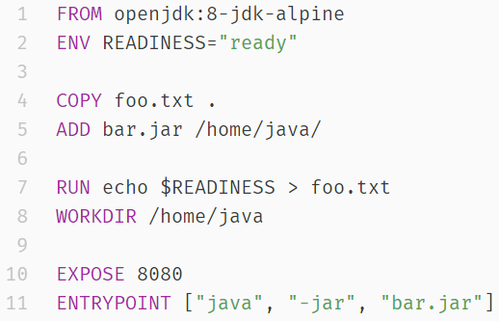
Dockerfile – Best Practices
Thinking in Layers:
A Dockerfile is a series of layers built on top of each other
Container images are build layer for layer
FROM defines the base image and version
ENV defines the environment variables
COPY and ADD basically do the same thing
Let you copy files from the host into the container
RUN let’s you execute a command
WORKDIR sets the working directory
EXPOSE forwards a port
ENTRYPOINT defines an command which will be bound to the container
Notes:
Um Container zu erstellen -> Dockerfile definieren
Dockerfile = einfache Textdatei mit Schritten als Anweisung für den Docker („Hafenarbeiter“)
Legen fest welches Basisimage, welche Schritte zur Vorbeitung, welche Aufgaben (Microservice Ansatz -> 1 Service = 1 Aufgabe)
Dockerfile erklären
Bauen des Container Images -> Layer für Layer
Layer 1 wird gebaut -> abgespeichert als Image
Layer 2 wird bei Erfolg an Image angehangen usw.
Fehler bedeutet nicht neubauen aller Layer
Letztes Image wird genommen -> neues Layer darauf gebaut
Ohne Entrypoint und command -> Container wird nach abarbeitung der aufgaben sofort beendet

Slide 14
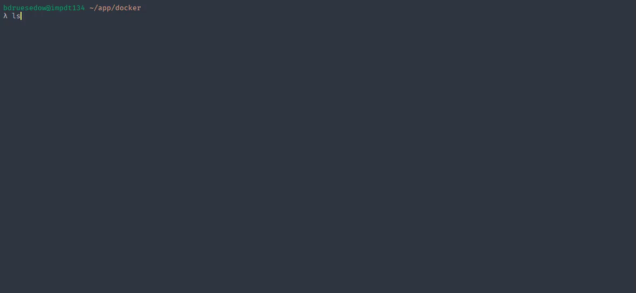
Dockerfile – Demonstation

Slide 15
Docker Compose
Tool for defining multi-container Docker applications
Uses YAML file to configure application’s services
Start services with one command

Slide 16
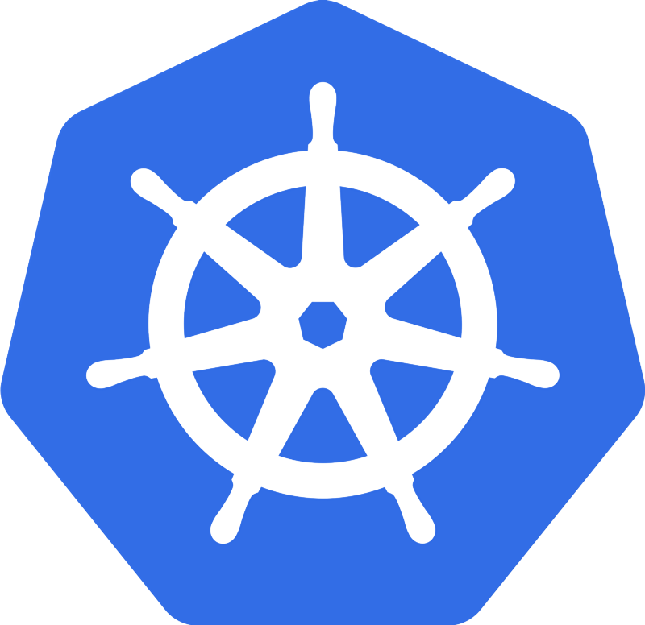
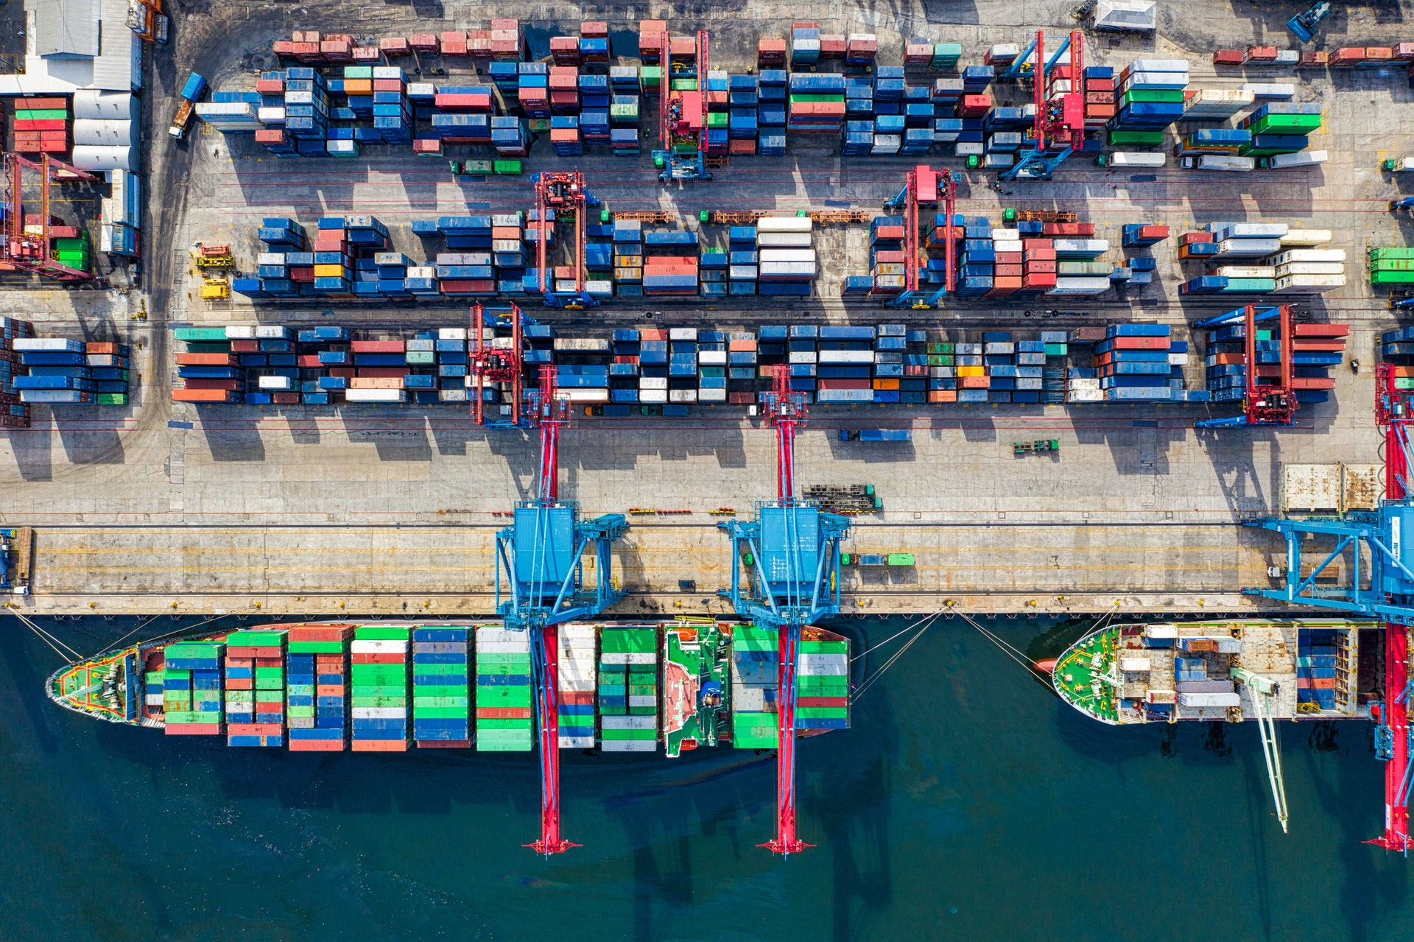
Kubernetes
Orchestrating containers is the next logical step after containerizing applications.
Kubernetes (K8s) is the “best-of-breed” of orchestration tools.
Kubernetes is the Greek word for “Captain”.
Designed by Google (2014) and now maintained by the Cloud Native Computing Foundation (CNCF)
K8s aims to provide a platform for automating deployment, scaling, operations and monitoring of application containers across a cluster of hosts.
Notes:
Orchestrierung von Containern ist nächster logischer Schritt
Best-of-Breed ist K8s
Griechisch für Kapitän
“verschiffen/liefern” vieler Container

Slide 17
Kubernetes vs Docker Swarm vs Apache Mesos
Kubernetes:
+ powerful orchestration tool
+ extensible
+ advanced features
- challenging to setup
Docker Swarm:
+ built-in Docker tool
+ simple to setup
- not as extensible as Kubernetes
Apache Mesos:
+ can also run multiple complicated applications (e.g. Multiple Kubernetes clusters)
- more suited for data-centers
Notes:
Kubernetes:
Sehr mächtige Technologie, weil:
Viele nützliche Features schon eingebaut hat
Aber auch erweiterbar
Aber: Anfang fällt schwerer als bei Docker swarm
Docker Swarm:
Zusammen mit Docker verfügbar
Einfach zu benutzen
Nicht so vielseitig wie Kubernetes
Mesos:
Kann auch nicht-containerisierte Anwendungen managen
Beispielsweise: in Mesos kann man mehrere Kubernetes Cluster laufen lassen
Deshalb aber auch passender in Data-Centern

Slide 18
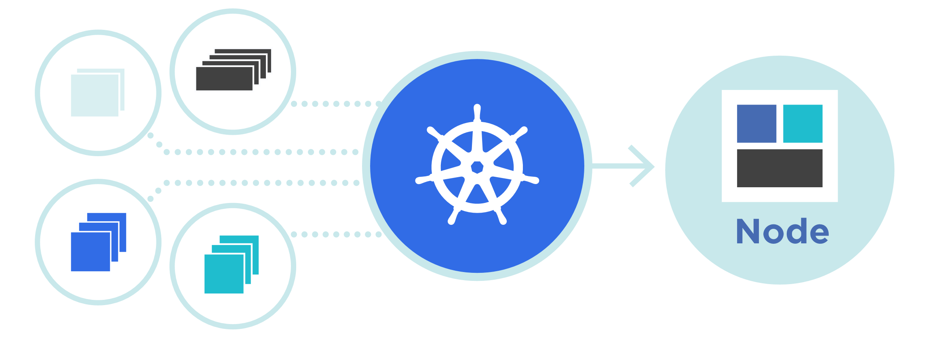
Kubernetes
Kubernetes …
groups containers and resources into logical units
automates the deployment, scaling and management of containers
keeps the modularity
simplifies large deployments and update of software

Slide 19
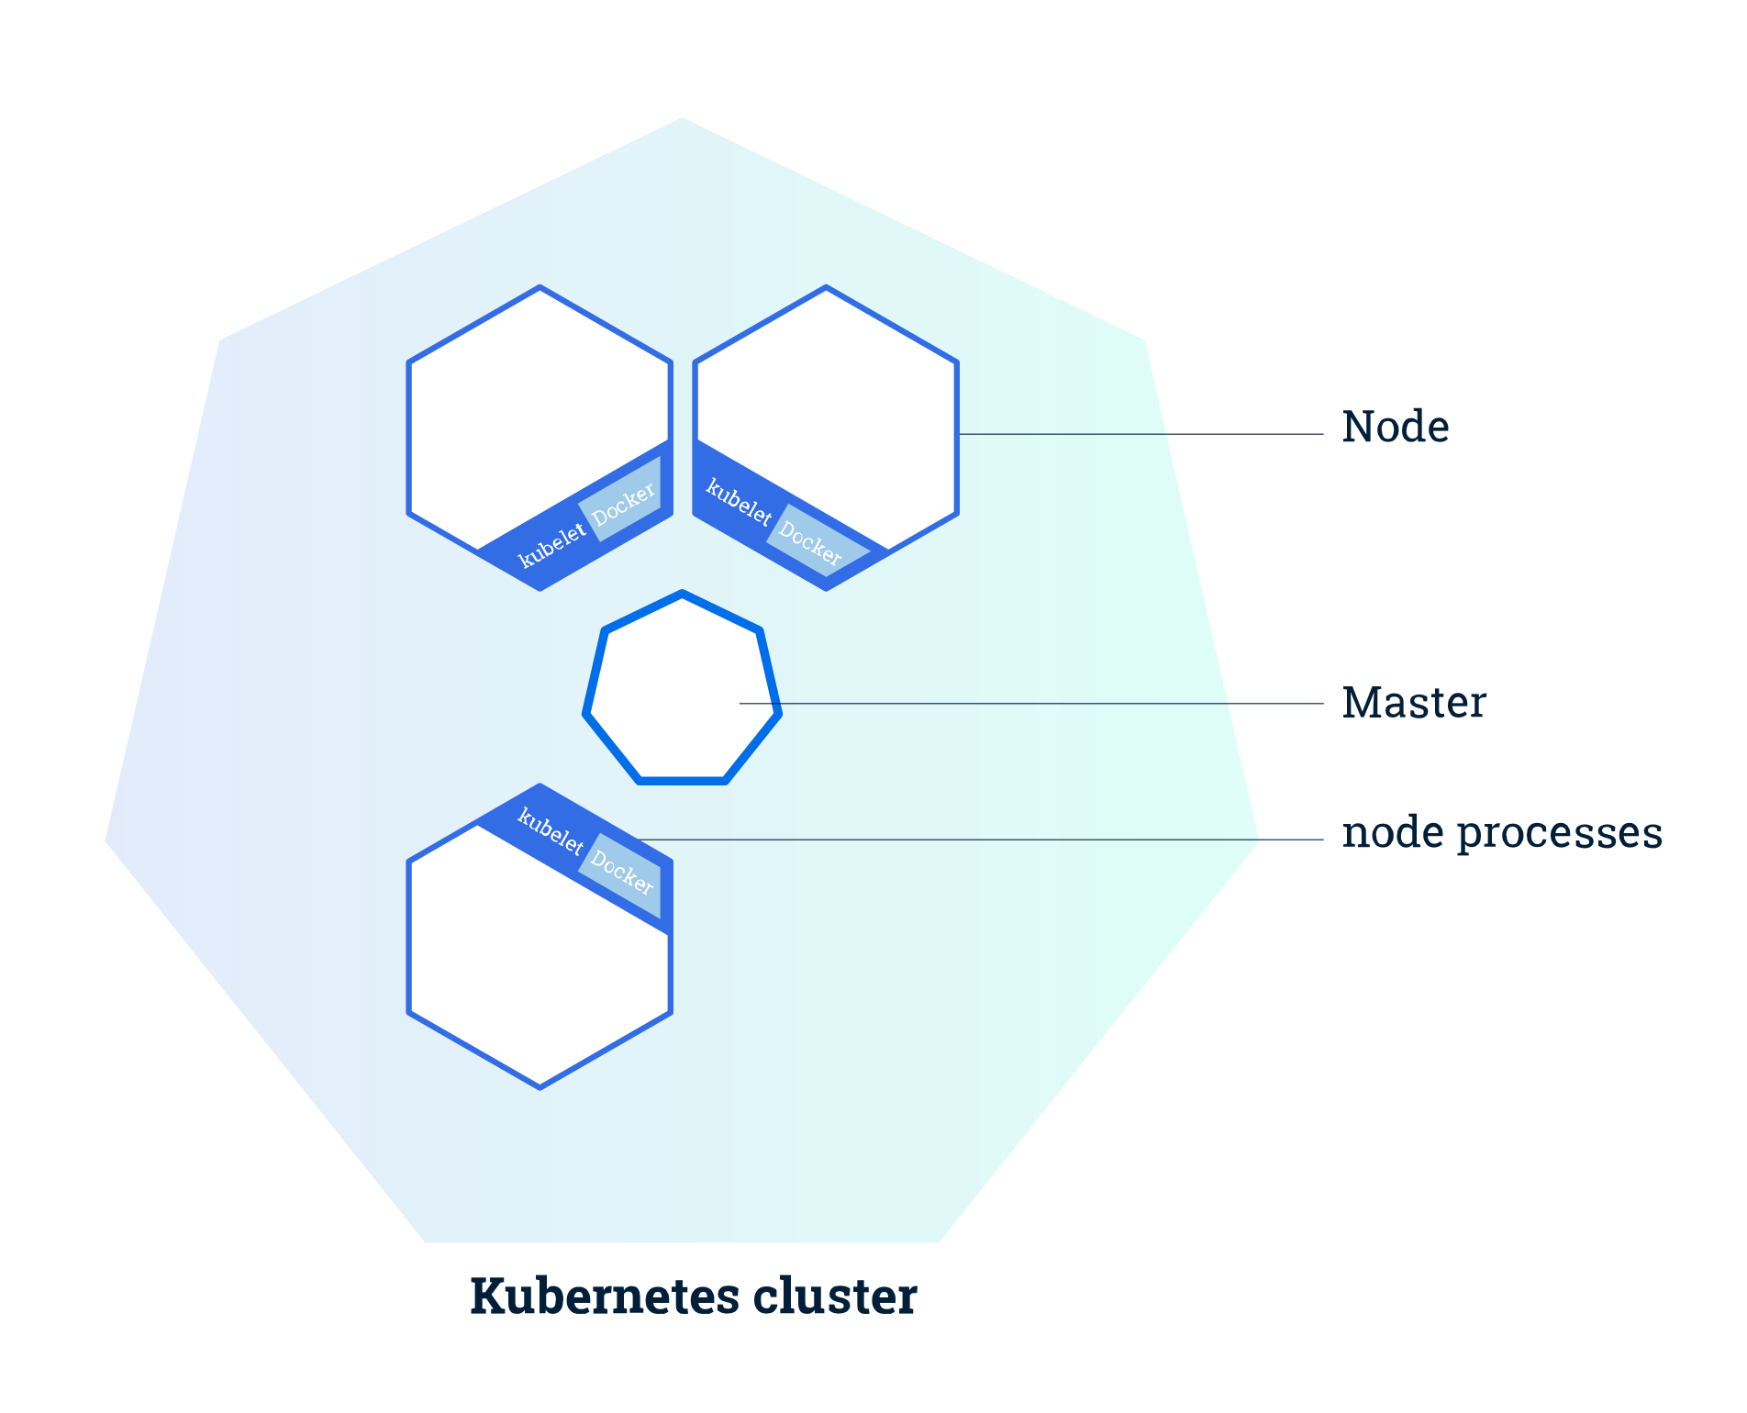
Kubernetes Architecture
Cluster and Nodes:
K8s coordinates a highly available cluster of computers that are connected to work as a single unit
Nodes are VM’s or physical Computers that serves as a worker machine
Master Node manages the whole cluster
Worker Nodes host the running applications

Slide 20
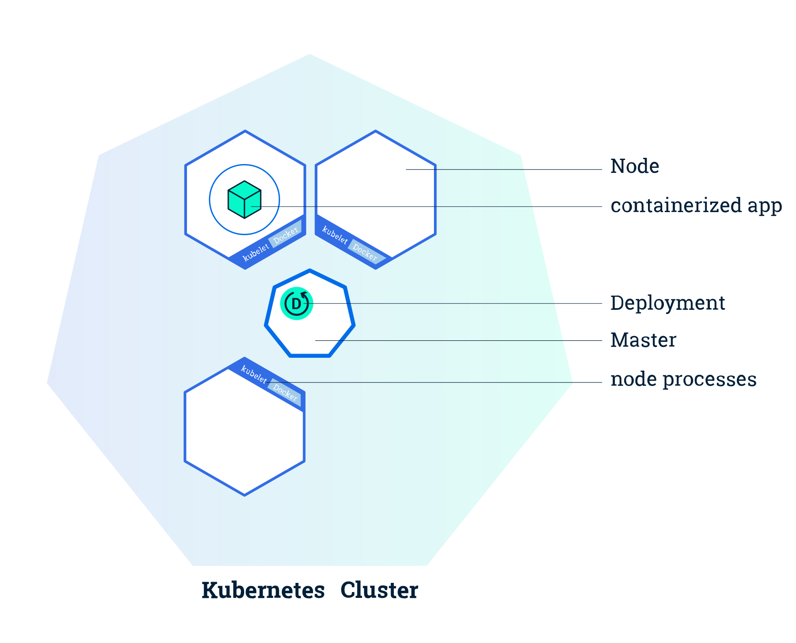
Kubernetes Architecture
Deployments:
Deployments create and update instances of the application
Managed by the master Node
Schedules application instances onto individual nodes in the cluster
Instances are monitored to provide a self-healing mechanism

Slide 21
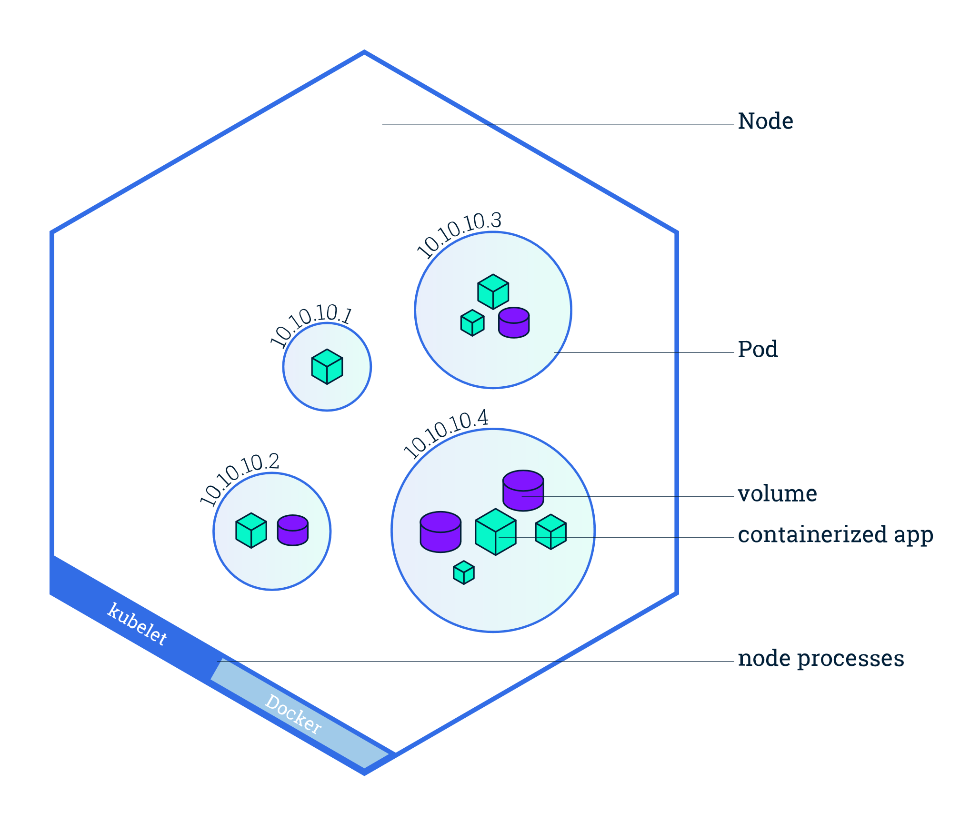
Kubernetes Architecture
Pods and Nodes:
Pod is a group of one or more application containers
Includes volumes, IP address and information about how to run each container
Pods run on Nodes
A Node can contain many Pods

Slide 22
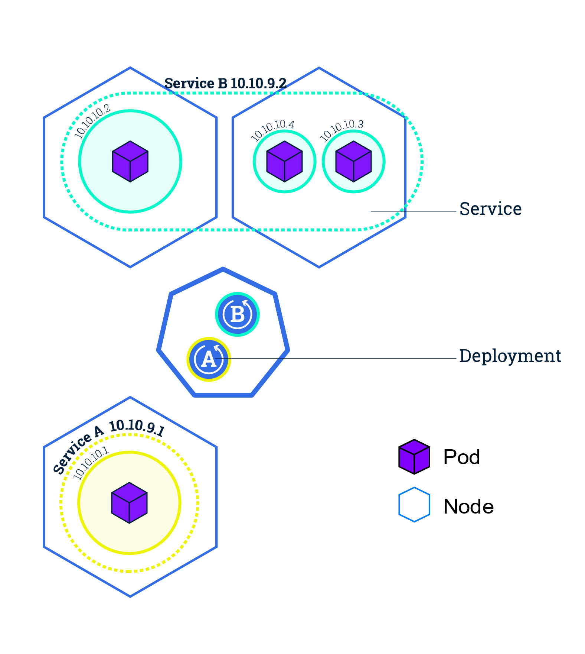
Kubernetes Architecture
Services:
A Service is an abstraction layer which defines a logical set of Pods
Enables internal and external traffic exposure, load balancing and service discovery for the pods
Service types: ClusterIP, NodePort, LoadBalancer, ExternalName
Allows Pods to die and replicate without impacting the application

Slide 23
Kubernetes Architecture
Secrets:
Contain a small amount of sensitive data (password, token, key)
Can be created by a user or the system
Ingress:
Exposes HTTP and HTTPS routes from outside the cluster to services in the cluster
Controlled by rules defined on the Ingress resource

Slide 24
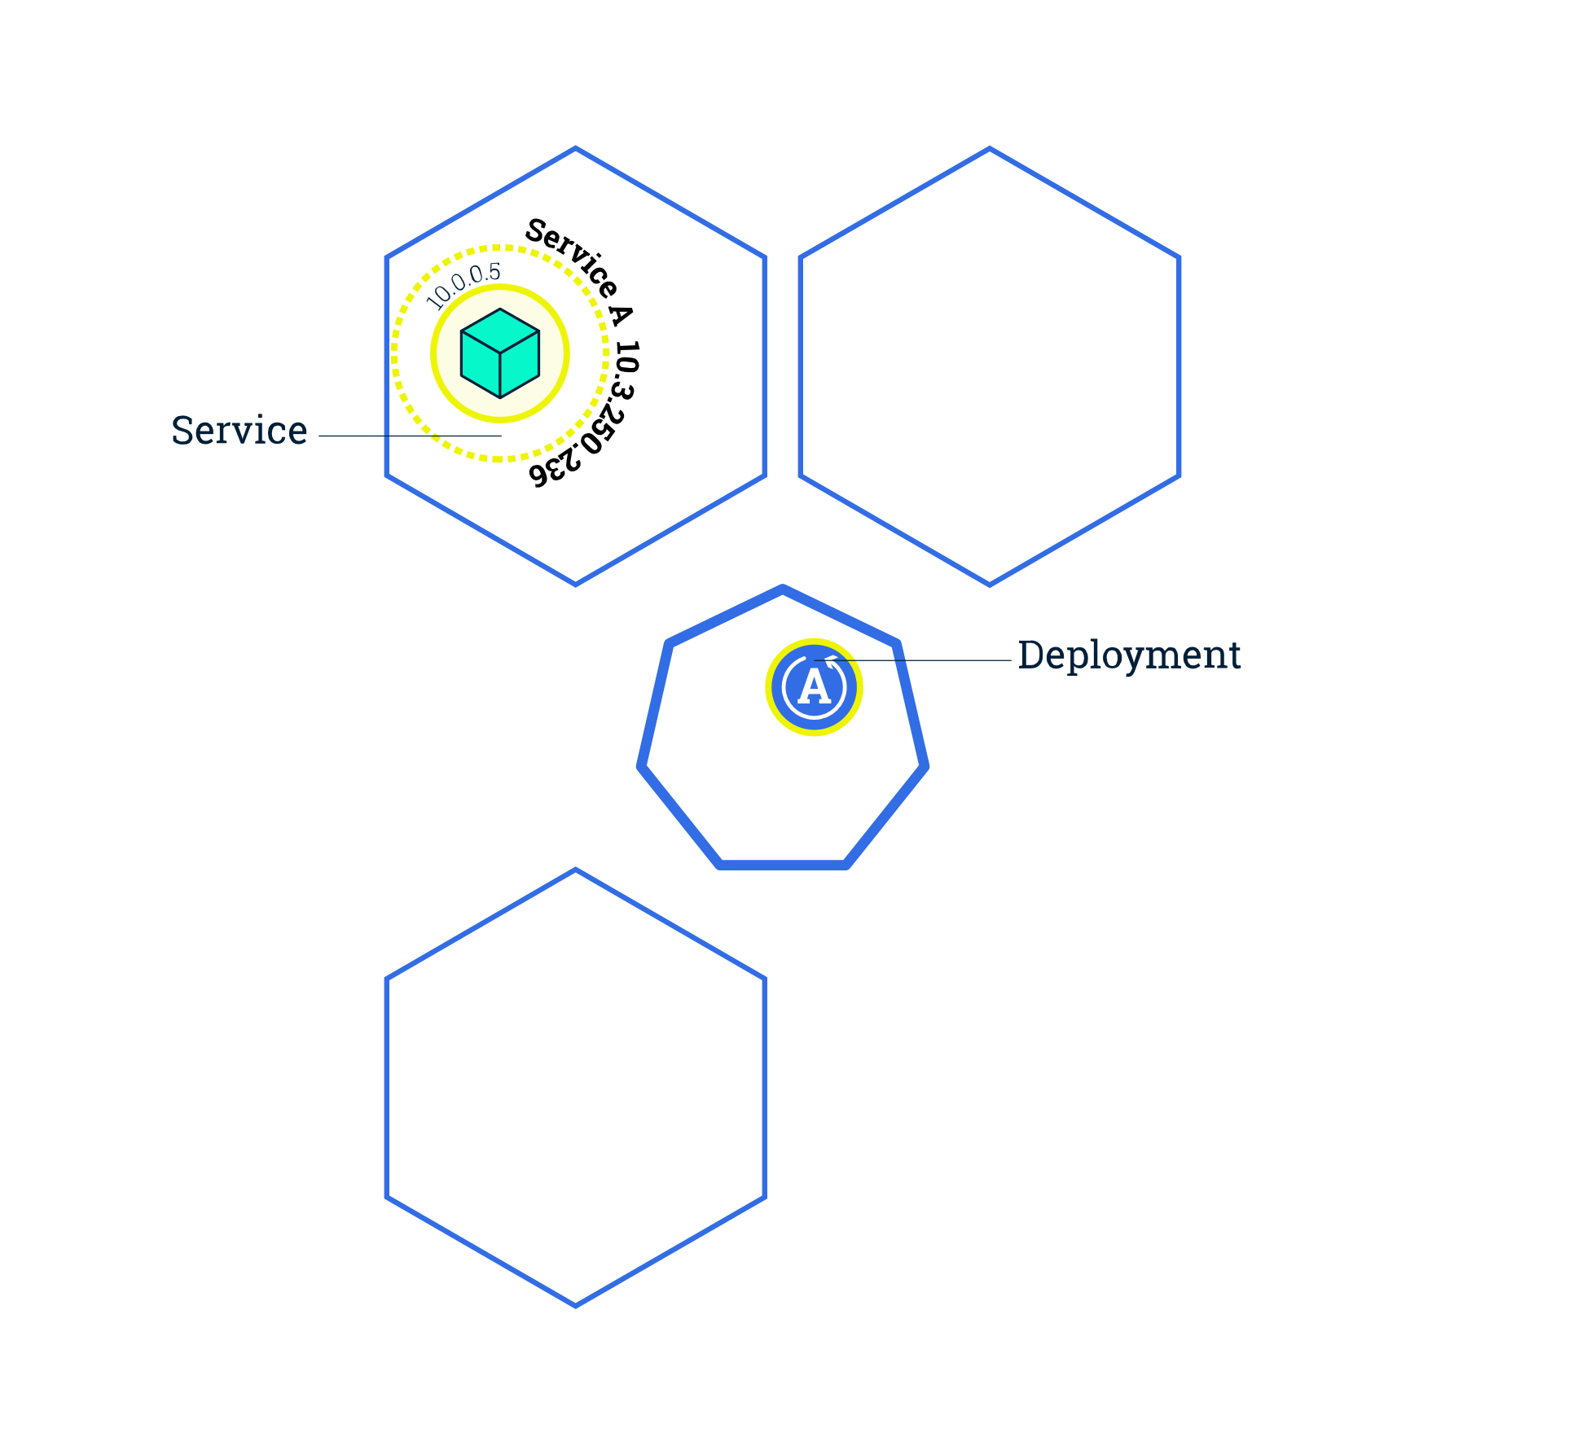
Kubernetes Features
Scaling:
Deployments can create multiple instances of pods by changing the number replicas
Will Schedule new pods to Nodes with available resources
Kubernetes supports autoscaling

Slide 25
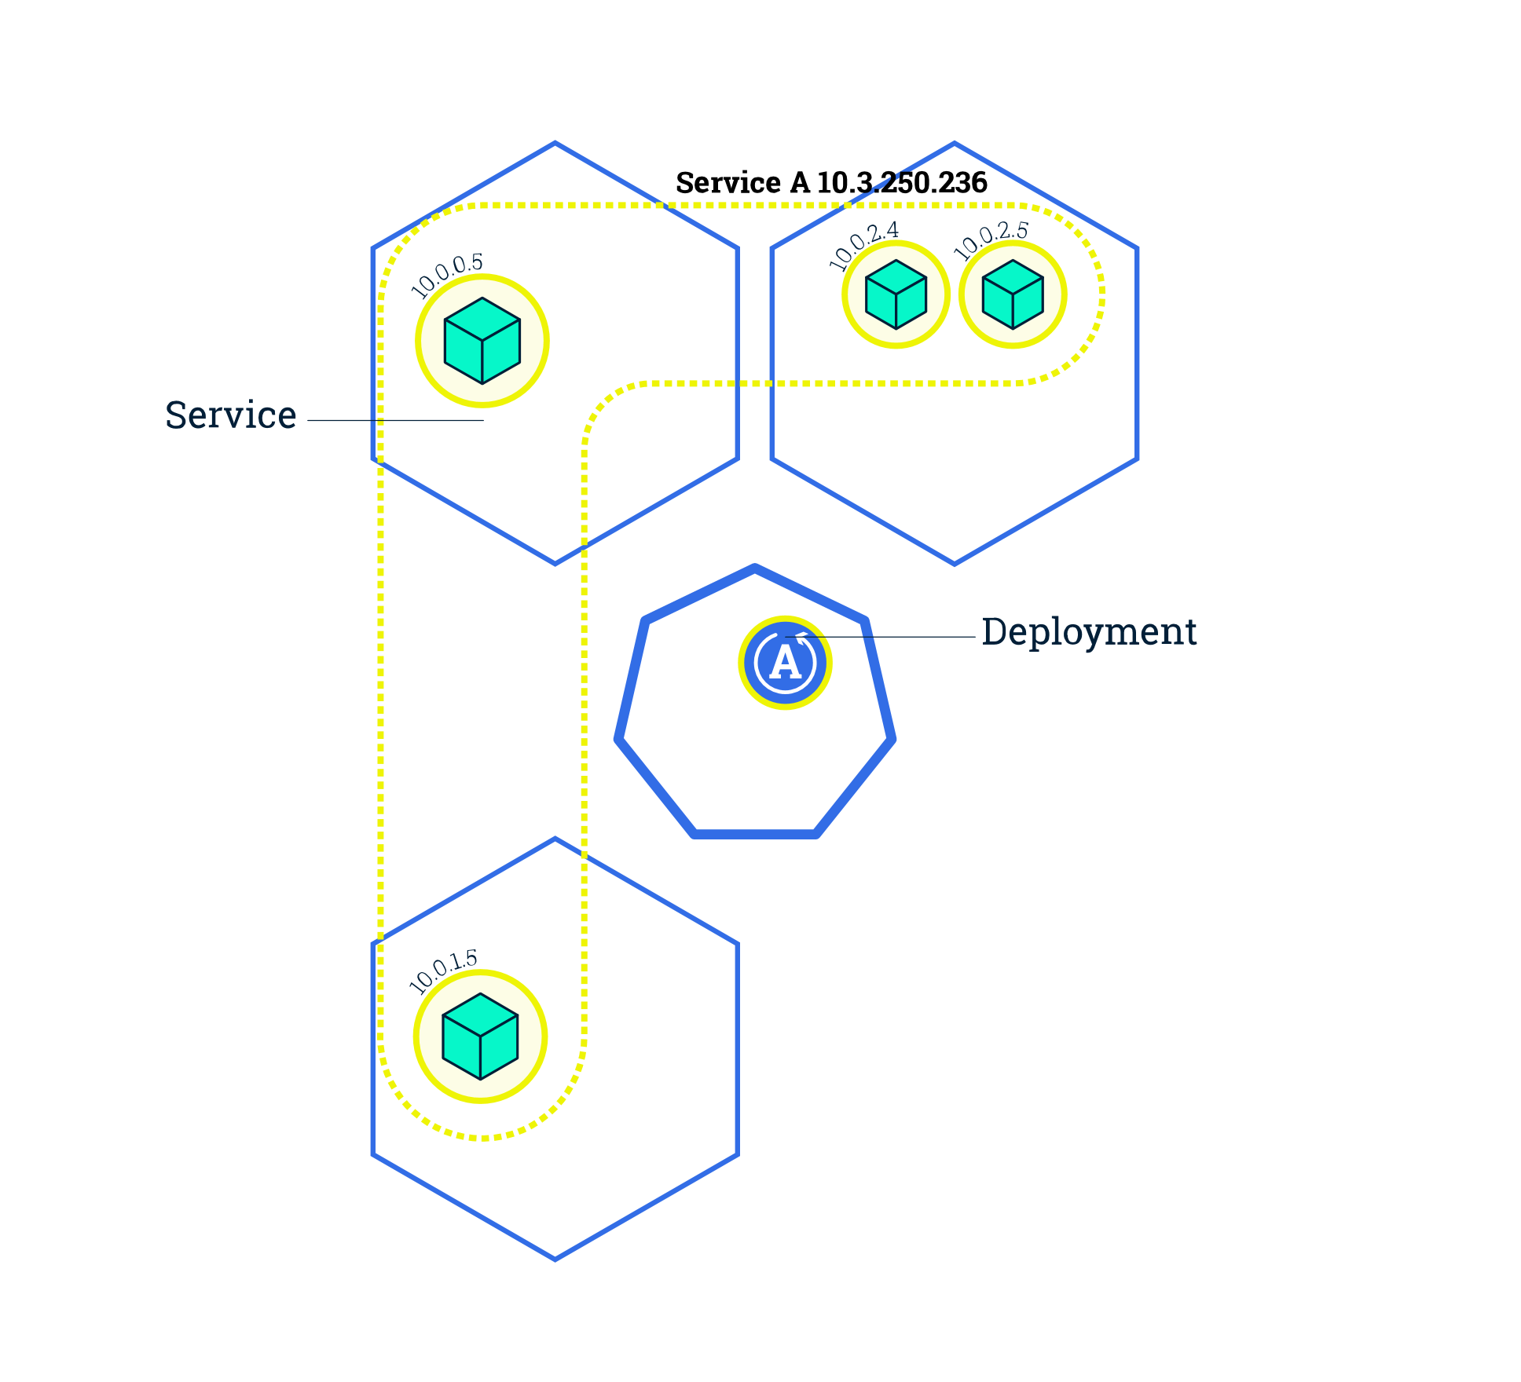
Kubernetes Features
Scaling:
Deployments can create multiple instances of pods by changing the number replicas
Will Schedule new pods to Nodes with available resources
Kubernetes supports autoscaling

Slide 26
Kubernetes Features
Rolling Update:
Application updates can be deployed as an rolling update with zero downtime

Slide 27
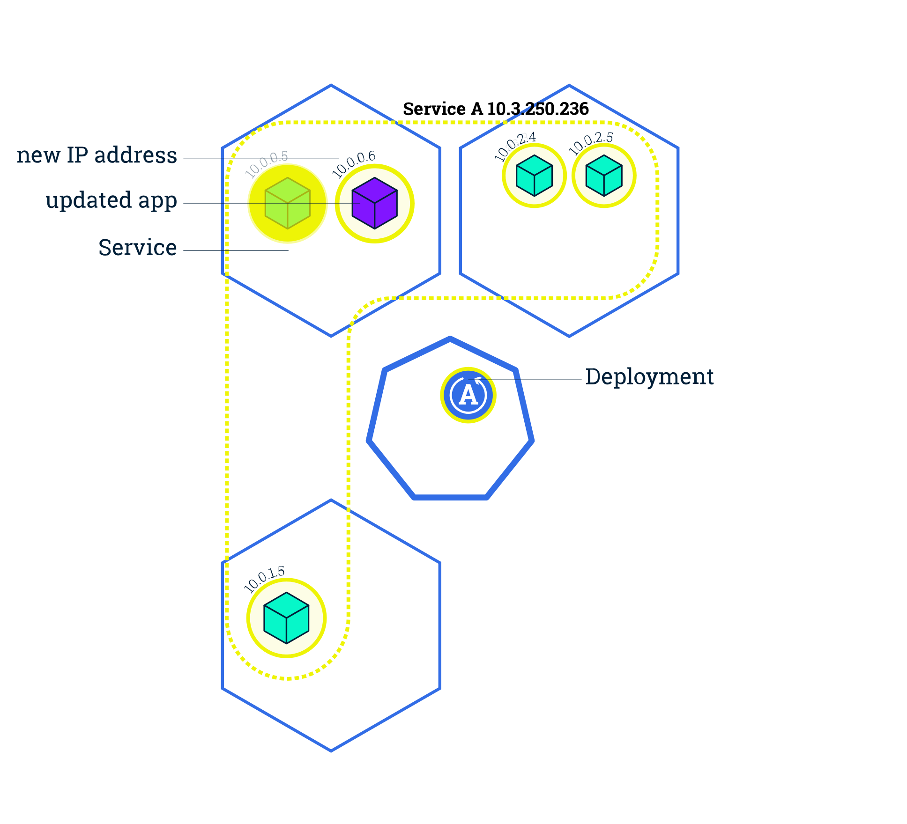
Kubernetes Features
Rolling Update:
Application updates can be deployed as an rolling update with zero downtime
New Pods will be scheduled on Nodes with available resources

Slide 28
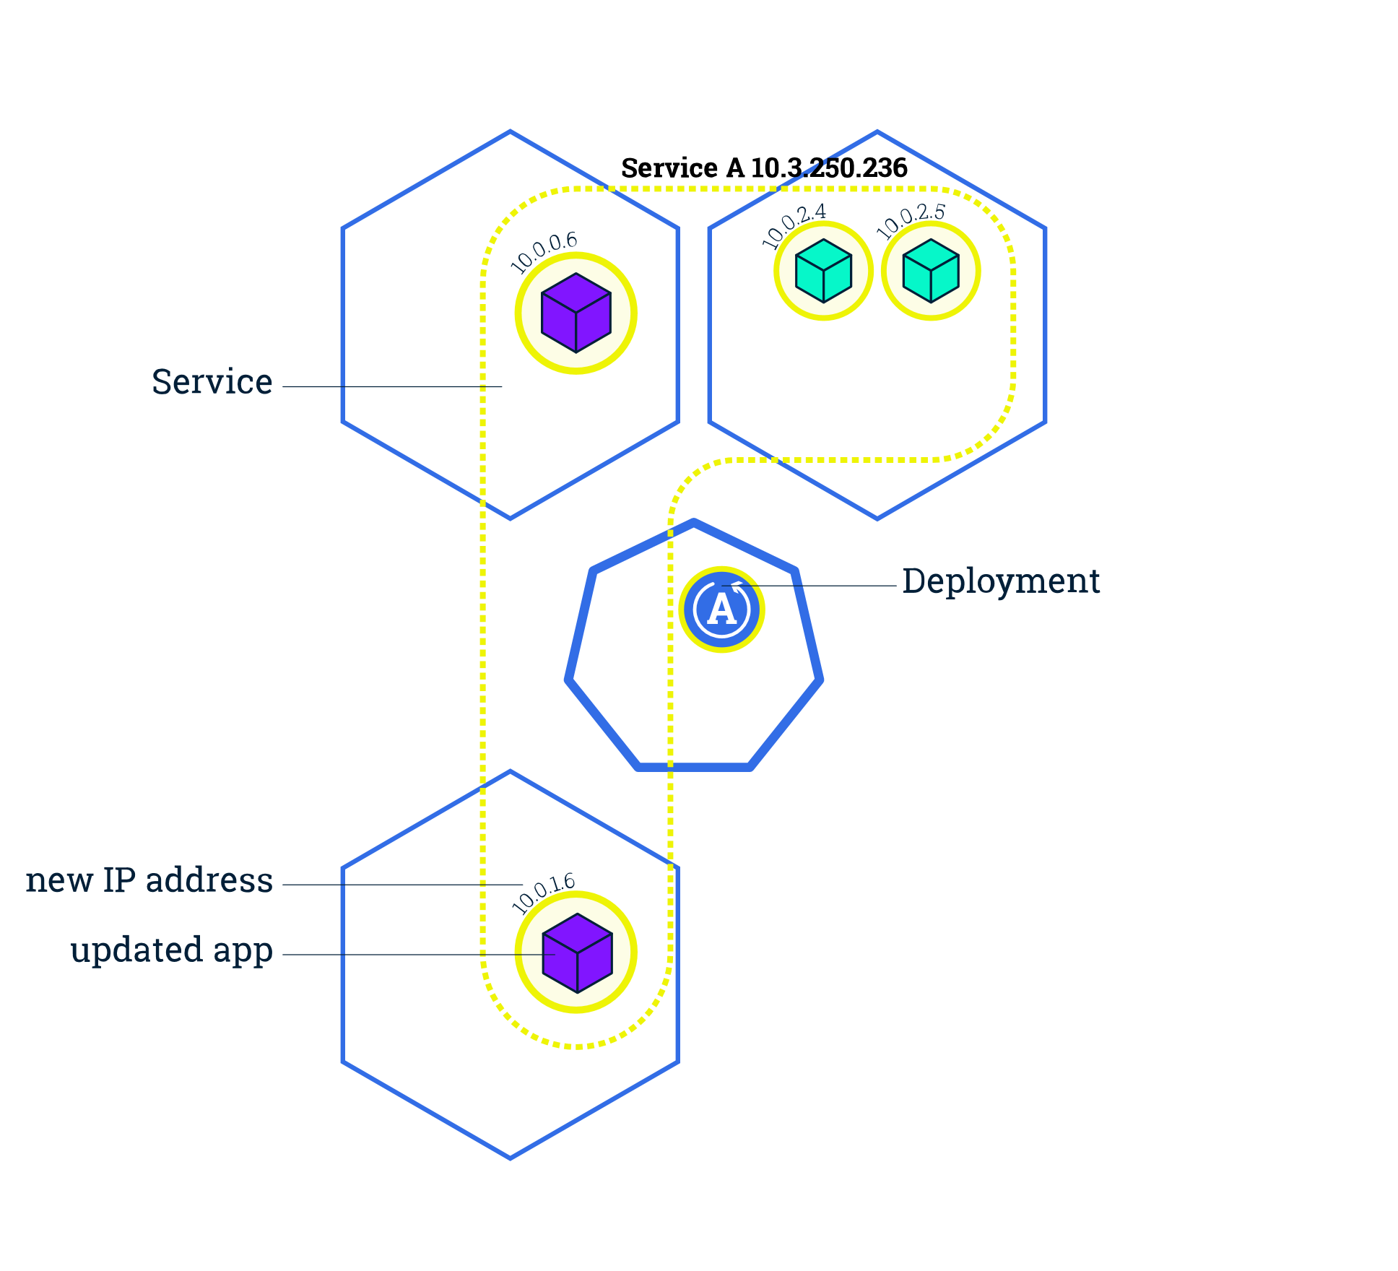
Kubernetes Features
Rolling Update:
Application updates can be deployed as an rolling update with zero downtime
New Pods will be scheduled on Nodes with available resources
Old Pods will be deleted when the new Pods are ready to use

Slide 29
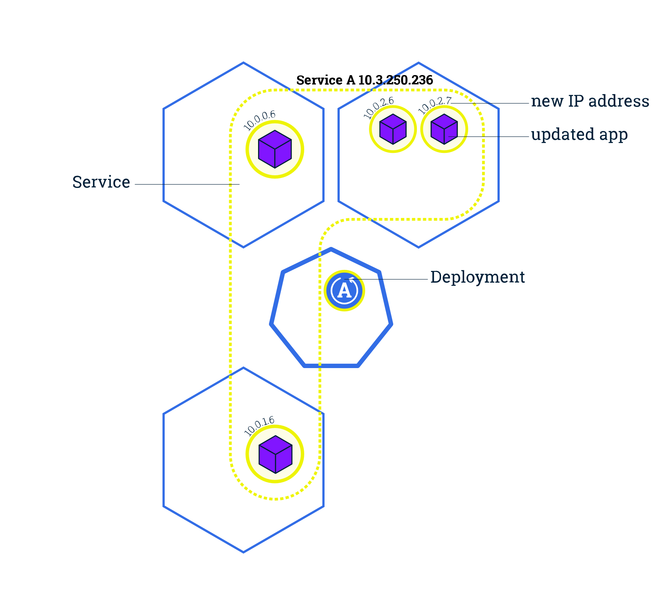
Kubernetes Features
Rolling Update:
Application updates can be deployed as an rolling update with zero downtime
New Pods will be scheduled on Nodes with available resources
Old Pods will be deleted when the new Pods are ready to use
Services will route the traffic only on available pods until the update is finished

Slide 30

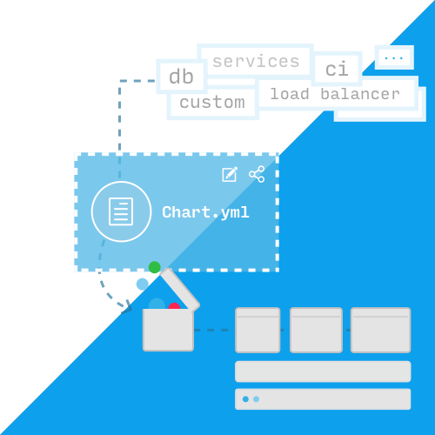
Helm – Kubernetes package manager
Helm …
is package manager for K8s, analogous to Apt or Yum in Linux
uses Charts as packages of pre-configured Kubernetes resources
makes Kubernetes Deployments reproduceable
Helm can …
install software
automatically install dependencies
upgrade software (rolling upgrade)
configure software deployments
fetch software packages from repositories

Slide 31
Helm Concept
What is a Chart?
A chart is a directory with YAML files that provides automation for Kubernetes objects for any given application.
chart.yaml contains version, description and sources that
are required to download the software to build.
values.yaml contains the default values for a chart. These
values can be overridden by users during helm install/upgrade.
my-chart/
|--- chart.yaml
|--- values.yaml
|--- templates/
| |--- configmap.yaml
| |--- deployment.yaml
| |--- service.yaml

Slide 32
Helm Concept
configmap.yaml is a definition of configurations that can be mounted into other K8s ressources.
deployment.yaml is a ressource definition for creating a K8s deployment that contains container, port, volume mounts, etc.
service.yaml is a ressource definition for creating a service endpoint for your deployment.
my-chart/
|--- chart.yaml
|--- values.yaml
|--- templates/
| |--- configmap.yaml
| |--- deployment.yaml
| |--- service.yaml

Slide 33
Why Helm?
Existing Helm Charts: Developers can modify existing charts or create their own.
Simlifies K8s Deployments: Helm releases make it much easier to deploy apps into a K8s cluster.
Mudularity: Allows the community to provide preconfigured apps that can be extended or configured for own needs.

Slide 34
Helm Architecure (v3.0.0)
Helm Client is a command-line client for end users.
Features:
Local chart development
Managing repositories
Managing releases
Interfaceing with the Helm library (upload/download charts)

Slide 35
Helm Architecure (v3.0.0)
The Helm Library provides the logic for executing all Helm operations. It interfaces directly with the K8s API server.
Combines a chart and configuration to build a release.
Installs charts into K8s and provides the subsequent object.
Upgrades and installs charts by interacting with K8s.
kubelet
kubectl
kubelet
API-Server
Helm Client
controller
manager
kube-dns
Helm Library
scheduler

Slide 36
Helm – Release Demonstration

Slide 37
Conclusion

Slide 38
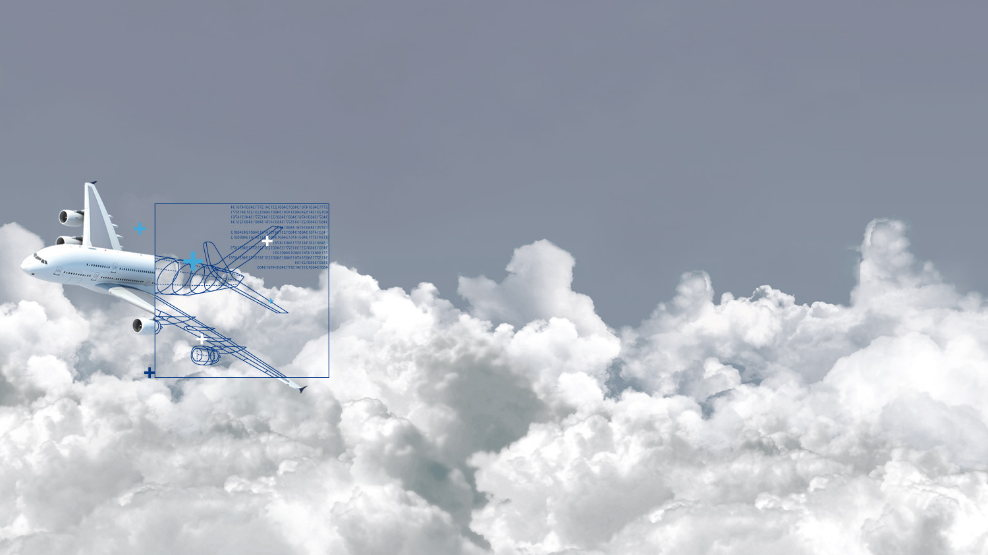
Vielen Dank.
Firmenzentrale
InMediasP GmbH
Neuendorfstraße 18a
16761 Hennigsdorf
www.inmediasp.de
info@inmediasp.de
Ansprechpartner
Vorname Name (name@inmediasp.de)
Vorname Name (name@inmediasp.de)

Slide 39

Hands-On
Exercise: github.com/bdruesedow/kubernetes-workshop

Slide 40

Prozesse.
Systeme.
Lösungen.

